Slide 1
Peristaltic Pump System
Mario Martinez - Electronics and Design Engineer

Slide 2
Description
Develop a fluidic system that can be operated at rated variable flow. The system should be able to pull fluid various reservoirs for 90 seconds then stop.
System user should be able to use a regulator to control the flow rate
The exact flow rate and system voltage should be displayed in a 16x2 LCD display
Pump needs to pull fluid from reservoir for 90 seconds then come to a stop
System should include a toggle switch which controls on/off state of pumps
The final system must have a PCB and a chassis that will hold everything in place

Slide 3
Safety
Potential risk of Shock
Burn from heat sink / solder iron
Wear appropriate PPE
Woodworking safety

Slide 4
Overall System
Reservoir 1
Fluidic Device 1-4
Power
Reservoir 2
Pump 1 & 2
Fluidic Device 5-8
Reservoir 3
Pump Controller
Pump 3 & 4
Reservoir 4
Pump 5 & 6
Fluidic Device 9-12
Reservoir 5
Pump 7 & 8
Reservoir 6
MCU
Fluidic Device 13-16
Reservoir 7
Reservoir 8
16 x 2 LCD
System Controls

Slide 5
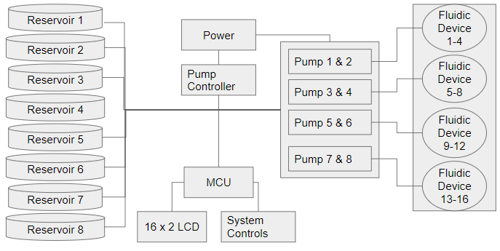
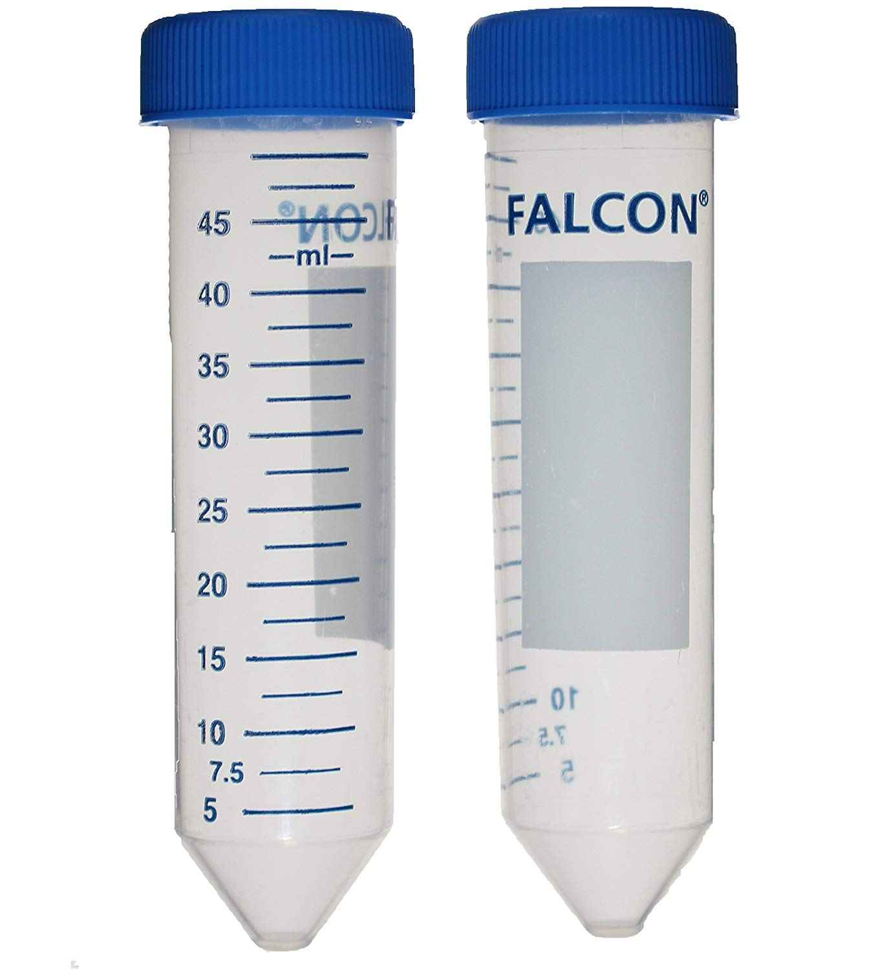
Liquid Reservoir
50 ml of fluid
Water will be used as test
Plastic material

Slide 6
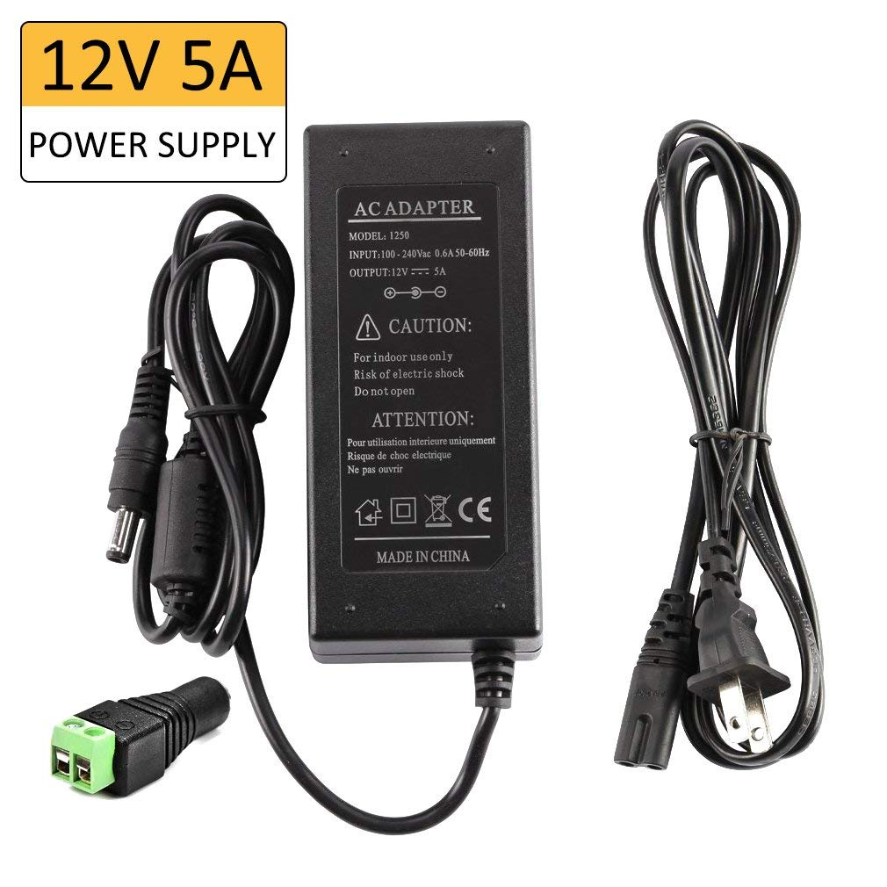
Power Supply
LEDMO
Output Voltage. DC 12V
Max Current 5A
Max Wattage 60W

Slide 7
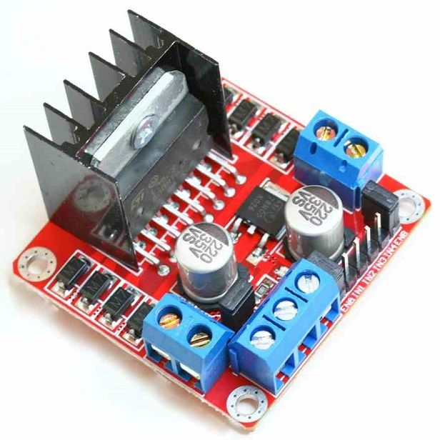
Pump Controller
L298N H-bridge
Op Voltage : 5V-35V
Drive current : 2A
Max power : 25W
Supplies 5V for MCU

Slide 8
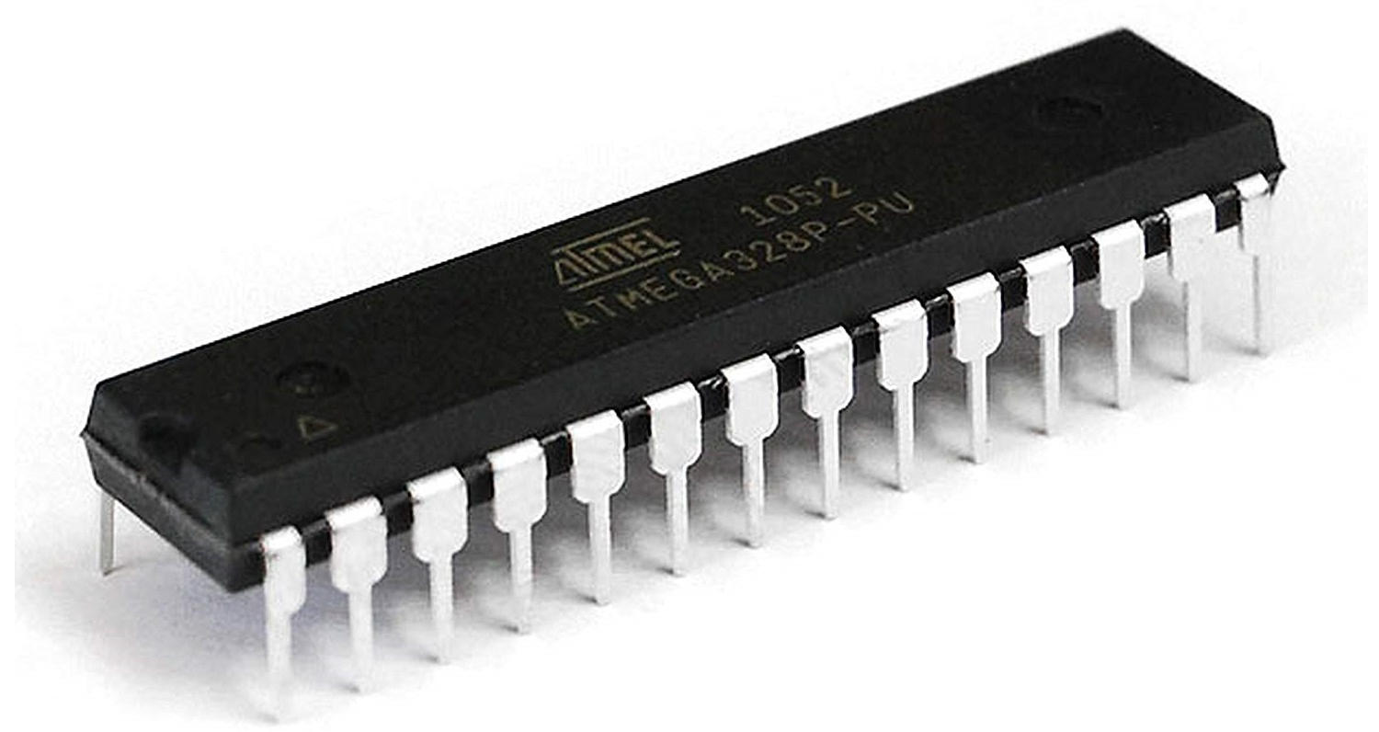
Micro Controller
Atmel - Atmega328P
Operating Voltage : 1.8V - 5.5V
Active Mode : 0.3mA
GPIO pins : 23
Arduino IDE

Slide 9
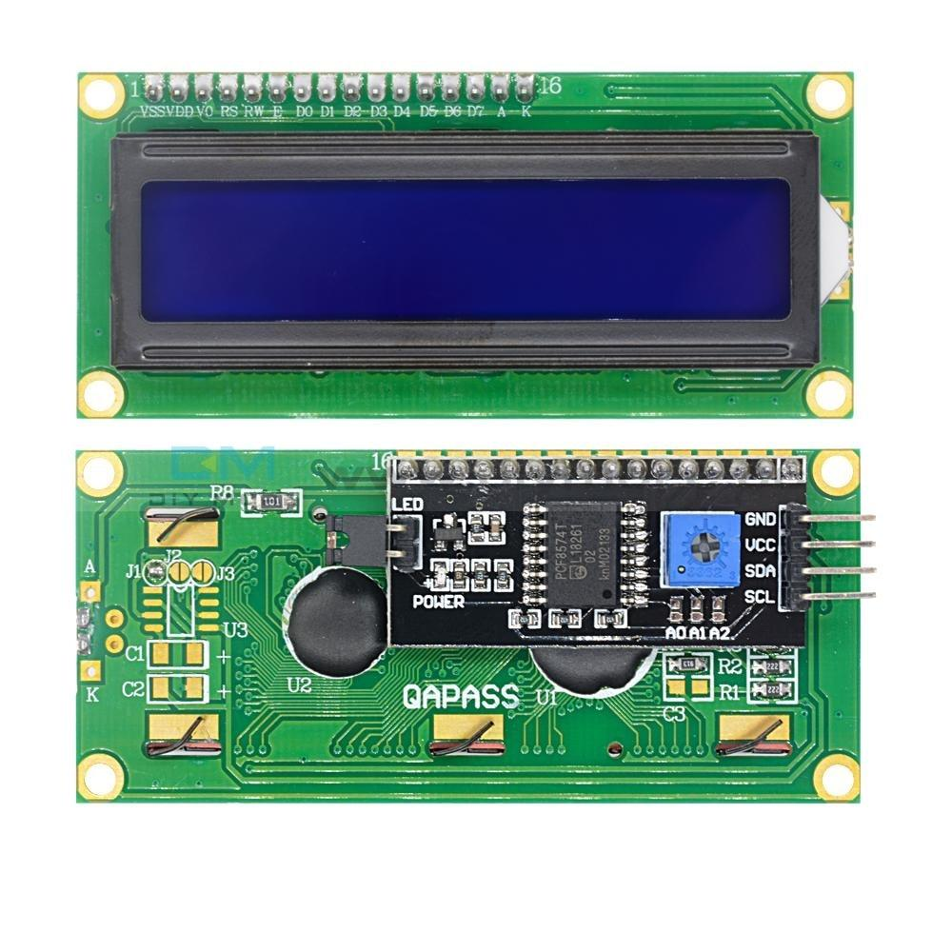
16x2 Character LCD
With I2C Module
Operating Voltage : 2.7V to 5.5V
Operating Current : .4mA

Slide 10
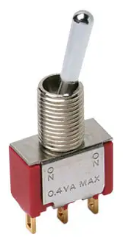
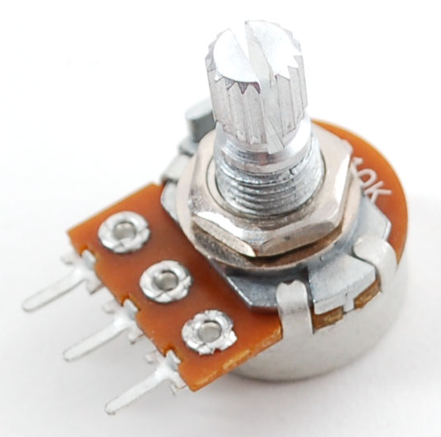
System Controls
10K potentiometer
Controls flow rate
5V 2A toggle switch
Controls state of system (on/off)

Slide 11
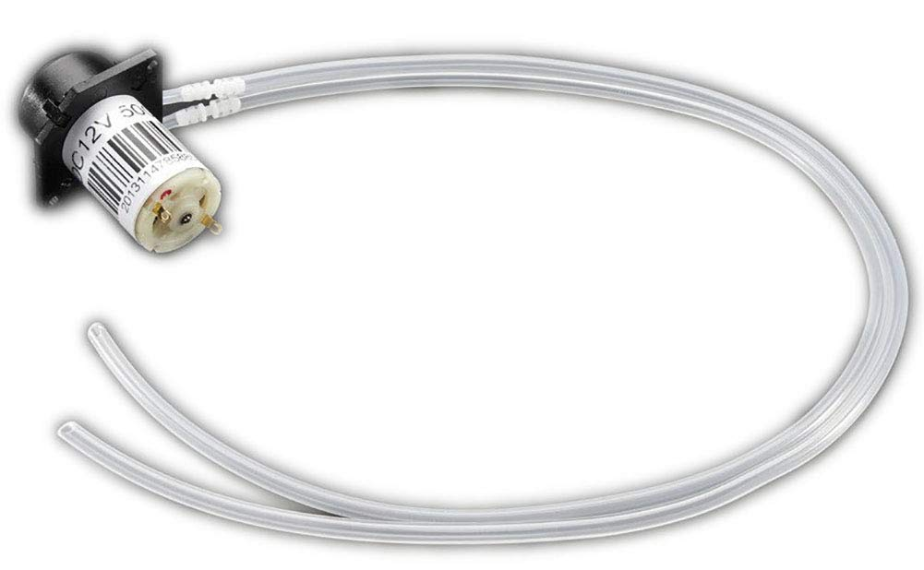
Peristaltic Liquid Pump
Adafruit
Motor voltage : 12VDC
Motor current : 200-300mA
Flow rate : up to 100 mL/min
RPM : 5000

Slide 12
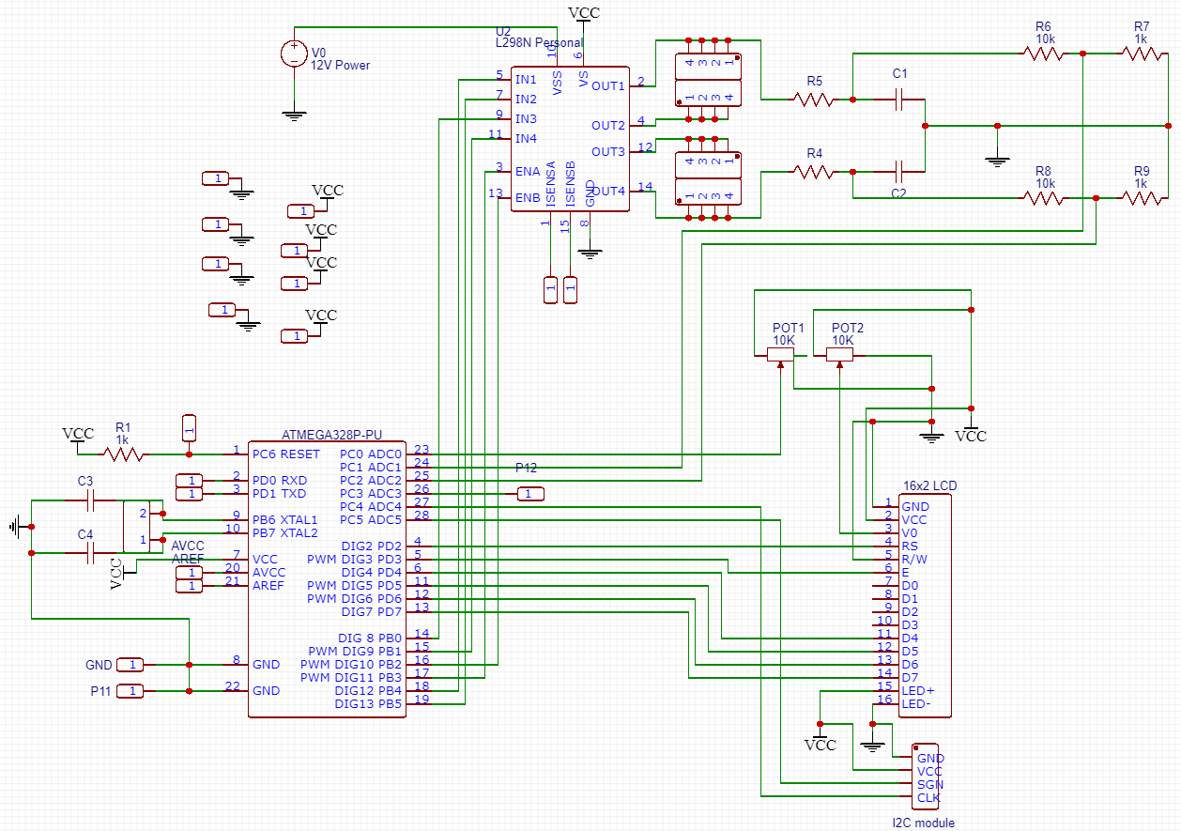
Circuit Schematic

Slide 13
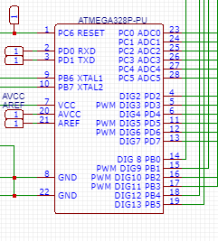
Circuit Schematic
MCU
Connects to :
LCD
User Controls
Pump Controller

Slide 14
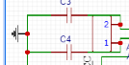
Circuit Schematic
MCU
ATMega independent from Arduino board
16 Mhz crystal
22pF capacitors

Slide 15
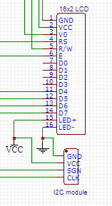
Circuit Schematic
LCD
2 LCD options:
Option to use 16 pin LCD
Option to use 4 pin I2C LCD

Slide 16
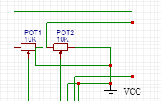
Circuit Schematic
User Controls
One 10K POT to control pump speed
One 10K POT to control LCD brightness (if 16 pin LCD is used)

Slide 17
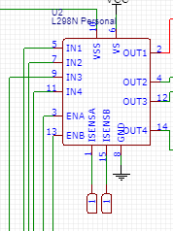
Circuit Schematic
Pump Controller
12V power supply in
5V out for system
MCU
LCD
User controls

Slide 18
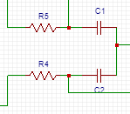
Circuit Schematic
Voltage Readings
RC Filter
RC filter reads voltage of motors
Reads between 0 to 12V

Slide 19
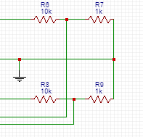
Circuit Schematic
Voltage Readings
Divider
10 to 1 voltage divider
Outputs between 0 to 1.2V

Slide 20
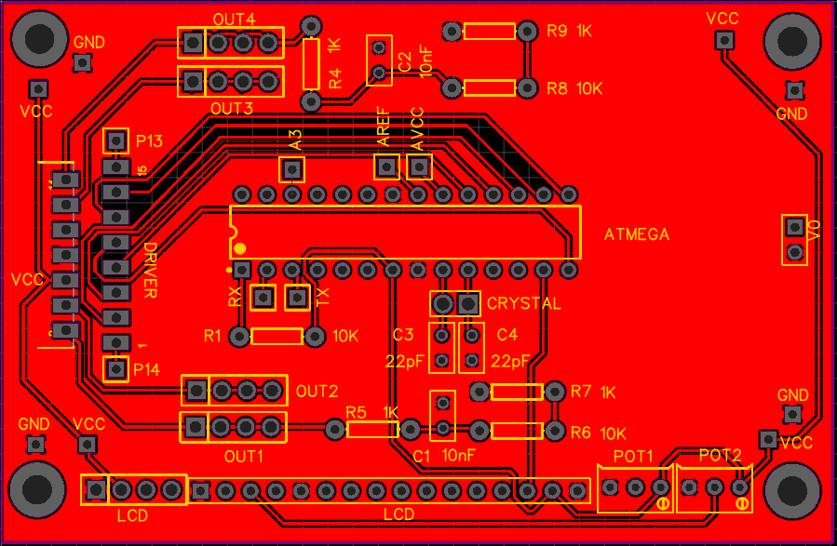
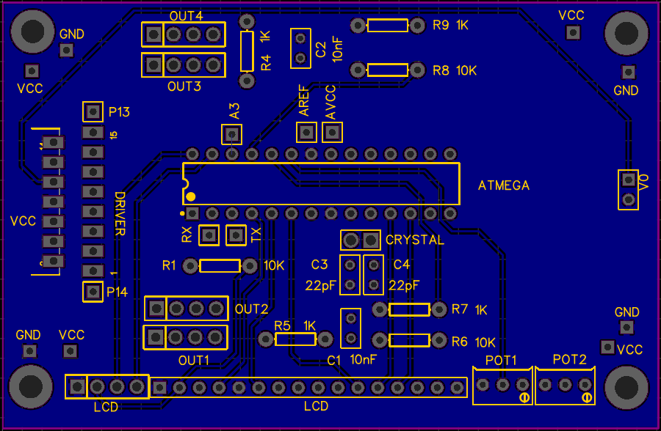
PCB
2 layers
.3mm trace width
.5 amp max
.9mm hole diameter

Slide 21
PCB
3mm holes for mounting

Slide 22
PCB
3mm holes for mounting
Extra GND and VCC

Slide 23
PCB
3mm holes for mounting
Extra GND and VCC
Holes for unused MCU pins

Slide 24
PCB
3mm holes for mounting
Extra GND and VCC
Holes for unused MCU pins
I2C module
LCD Pins
Control Pins

Slide 25
PCB
3mm holes for mounting
Extra GND and VCC
Holes for unused MCU pins
I2C module
LCD Pins
Control Pins
MCU

Slide 26
PCB
3mm holes for mounting
Extra GND and VCC
Holes for unused MCU pins
I2C module
LCD Pins
Control Pins
MCU
Motor Driver

Slide 27
PCB
3mm holes for mounting
Extra GND and VCC
Holes for unused MCU pins
I2C module
LCD Pins
Control Pins
MCU
Motor Driver
Motor pins

Slide 28
Code
Flowchart
Read POT
Read
switch
Is switch on?
no
yes
Motors off
Motors on
yes
no
Have 90 sec passed?
Motors are on
Display voltage and Flow

Slide 29
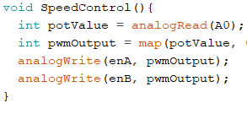
Speed control
Reads input from potentiometer
Outputs to enA and enB of motor Driver

Slide 30
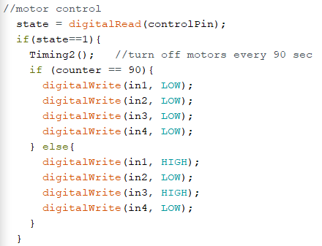
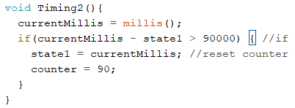
Motor control
When switch is off, motors are off
When switch is on, Timing2() occurs
Timing2() turns off the motors after 90 sec.

Slide 31
Flow and Voltage Calculations
Voltage is calculated by reading voltage from RC filter and Dividing by 10 (10:1 divider) for MCU to read, then multiplied by 10 for display.
Data is filtered using an exponential filter library
Flow rate is physically measured from Min to Max operating pump voltage in 4-6 stages.
Online polynomial regression tool (4th degree) used to fit curve for measured flow rate for display

Slide 32
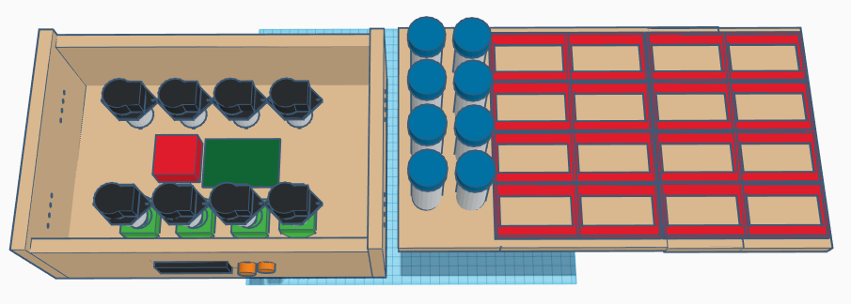
Design
test tubes
Mounts underneath
pumps
Holes for tubes
Microfluidic device mounts
Display and controls
Mounts for pumps

Slide 33
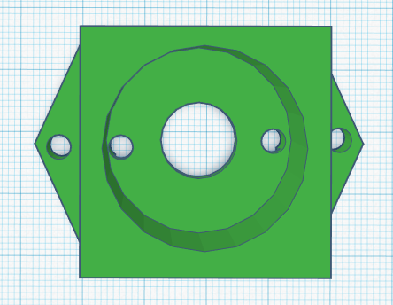
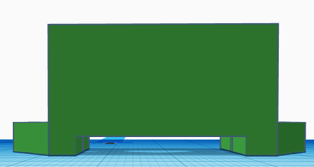
Pump mount
Screws go in here
Screws onto wooden base
Motor wires run underneath mount
Holes for motor pins

Slide 34
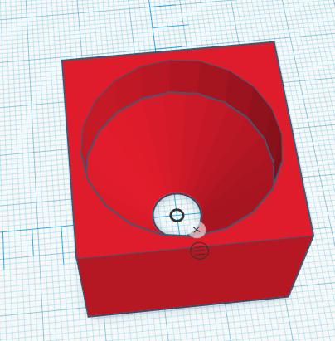
Tube mount
Glued underneath top

Slide 35
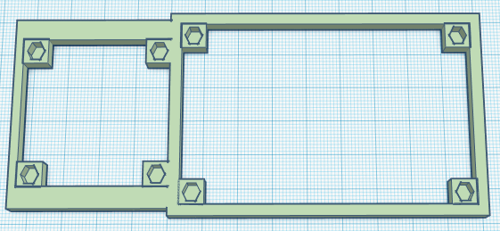
PCB and motor mount
Glued to base
3mm Brass insert

Slide 36

Conclusion - Accomplishments
Have flow regulator and pump working for output. (Feb)
Timing, Proper Display of Data (March)
Prototype 3D design and make PCB (April)
Finalize and assemble everything in 3D printed enclosure (May)

Slide 37
Conclusion - Unfinished goals
Tube routing
Master on/off/reset switch
Enclosure for PCB for spills

Slide 38
Conclusion - Changes
Use a different motor driver (for 8 pumps)
Some pumps do not flow the same as others
Change layout of PCB
Change layout of pumps and PCB mount
Easier to change connections/debug when tubes are not above mounts

Slide 39
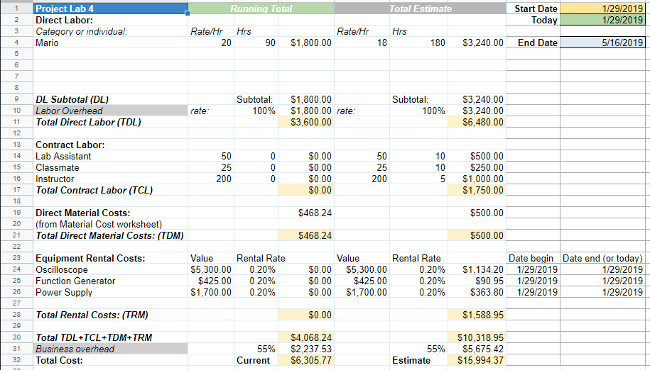
Budget

Slide 40
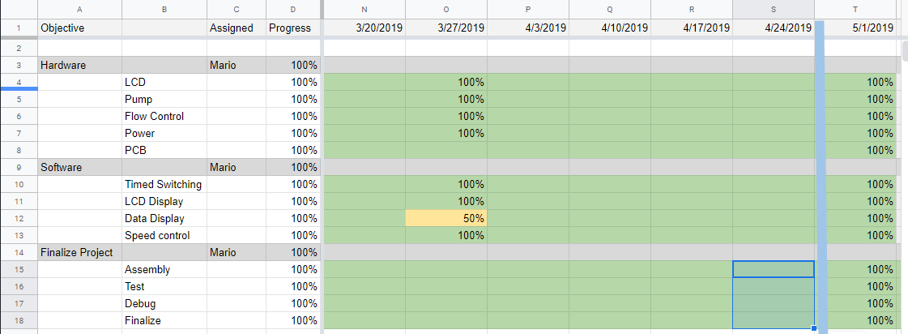
Gantt Chart

Slide 41
Questions?

